Slide 1
Jed Brundidge
Eric Buhr
Ashirwad Shrestha

Slide 2
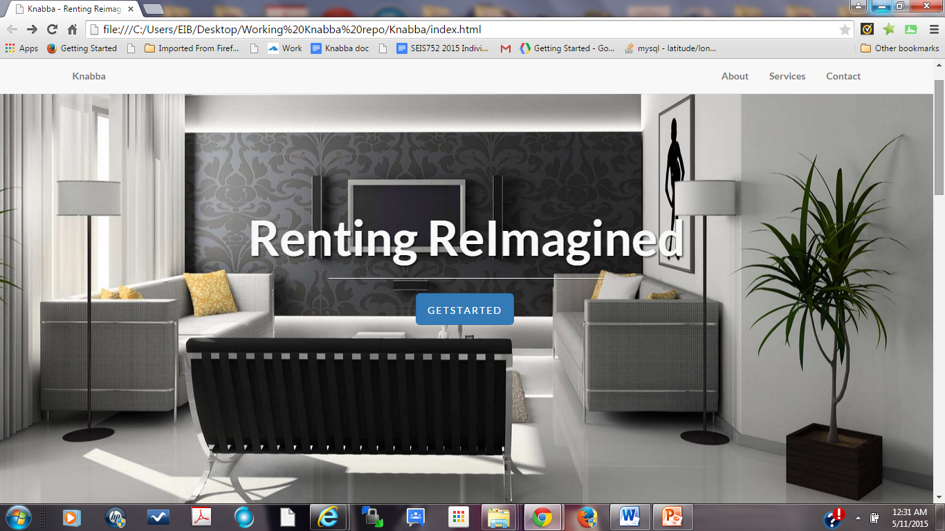
“Simplicity is the glory of expression.”
-Walt Whitman-

Slide 3
Business Problem
Renters challenges
Locating property under tight deadlines
Finding location before someone else signs lease
Time and effort is wasted when already rented
Landlord challenges
Finding qualified tenants
Adds costs for upkeep or uncertainty with unreliable tenants.

Slide 4
Solution
Match-making model using a web application
Rental connection bringing landlords of desirable properties and qualified tenants together.
Similar concept to Thumbtack

Slide 5
Goals and Concepts
Create a working prototype based on initial features
Users: landlords and tenants
Landlords search for/choose tenants
Both have profiles
Relationship based on offer/response action
Anything not feasible pushed to future versions

Slide 6
Basic process
Landlords
Sign-in
LL Profile
Offer
New Users
Tenants
Landlords
Login
T Profile
Existing Users
Tenants
Response

Slide 7
Diagram
Users
API’s
Database
Landlords
Client side
Server side
HTML
JS AJAX
MySQL
PHP
JSON
XML
Tenants

Slide 8
Thoughts behind choices
Database design – first two separate tables--but users share a lot of data decided on one
Only access is different- initiated by landlord
Bootstrap – great for look and feel – mobile friendly
MySQL – some basic security – username/PW
Google Maps – Search query on SQL side
Photo upload – save photo in db like Flickr API

Slide 9
Technologies
HTML5
CSS
JS
PHP
MySQL
JSON
XML
AJAX
Bootstrap
Foundation
Lightbox
jQuery
Github
API’s
Oauth (FB)
Google Maps

Slide 10
Challenges
Working with Business Team
Absorbing a new team member
Design of database
Multiform design and validation
PHP syntax
SQL query & syntax
XML with Google Maps

Slide 11
Initial features
User account creation
User login
Landlord accesses tenant profiles
Create/send rental offer (landlord)
Respond to offer (tenant)
Each record has about 25 fields (details)
All initial features are completed.

Slide 12
Nice to haves
Upload photos to landlord profile
Preference-based search of tenants*
Mobile-friendly format
email subscription*
*not completed

Slide 13
Other completed features
FB Oauth
Geocoding and map search function
Optional tenant photo

Slide 14
If we had more time. . .we just might
Security
Add Google and Twitter Oauth
Overlays (circles) and clusters on map search
Revisit data architecture
Consider Angular JS as alternative to jQuery
Email notification of offer/reply
Use JSON in more cases

